Slide 1
RVIZ Examples
Manipulator Modelling in RVIZ

Slide 2
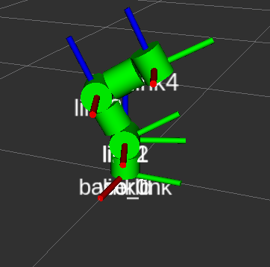
Introduction
Introduction
In this tutorial, the user will build a simple robot manipulator, skeleton using basic markers from RVIZ.
This tutorial will guide the user through all the necessary steps to simulate the manipulator using the concepts of transforms and markers in ROS.

Slide 3
Creating the package
Requirements
Ubuntu in VM (MCR2 VM) or dual booting
ROS installed (if not follow the steps in this link and select full installation)
Workspace “catkin_ws” created following the steps here (if you are using the VM this is already done for you).
Creating a package
Create a package called “simple_manipulator”. The dependencies used are rospy, std_msgs, geometry_msgs, visualization_msgs tf2_ros tf_conversions. Open a terminal and type the following
Beware that the command “catkin_create_package” must be run inside the “src” folder.
Once the package is created you will be able to see the package folder in ~/catkin_ws/src.
Build the package you just created and add it to your environment (more information here)
$ cd ~/catkin_ws/src
$ catkin_create_pkg simple_manipulator std_msgs rospy geometry_msgs visualization_msgs tf2_ros tf_conversions tf2_geometry_msgs
$ cd ~/catkin_ws
$ catkin_make
$ source devel/setup.bash

Slide 4
Creating the package
Creating and Configuring the Node
Create a folder for the Python scripts that will be used for each node and generate a Python script called “manipulator.py” inside the scripts folder.
Since the “talker.py” is an executable script, you need give permission to ubuntu to run it.
Open the file CMakeLists.txt in the folder “~/simple_manipulator/CMakeLists.txt” and find the following line
Uncomment it (remove the #) and add the highlighted line in yellow. This makes sure the python script gets installed properly and uses the right python interpreter
catkin_install_python(PROGRAMS scripts/manipulator.py
DESTINATION ${CATKIN_PACKAGE_BIN_DESTINATION}
)
$ cd ~/catkin_ws/src/simple_manipulator
$ mkdir scripts
$ cd scripts
$ touch manipulator.py
$ sudo chmod +x manipulator.py

Slide 5
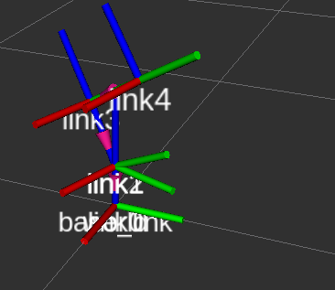
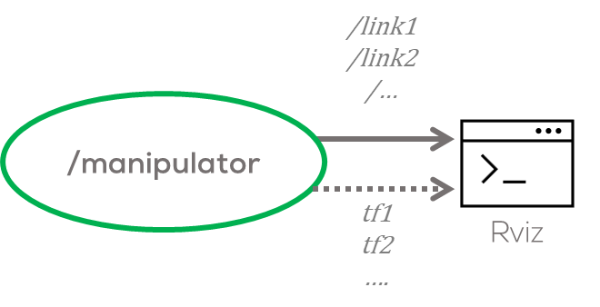
Creating the node
Coding the node
This node will configure and broadcast/publish the necessary transforms, and visualisation messages to visualise a simple manipulator.
A graphical representation of this task will look as follows

Slide 6
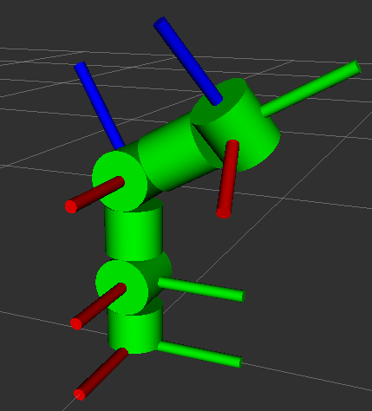
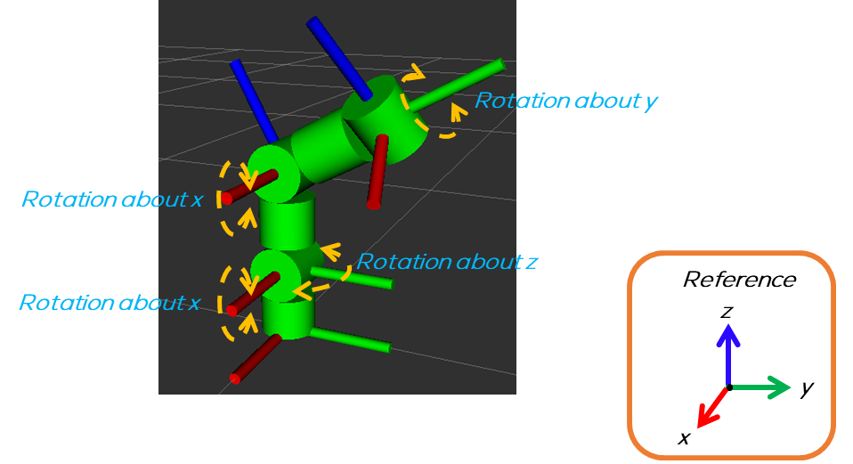
Robot Description

Slide 7
Code
Code Development
The code development will be divided into two parts.
In the first part, the previously defined transforms will be coded and tested to make sure they work properly.
In the second part of this tutorial, the markers necessary for visualising the manipulator will be defined.
Code Development
The complete code structure to be used for this ROS node will be divided into three different sections, declaration, main setup and loop.
Declaration: In this section, the user will define the variables to be used, type of messages, transforms, and functions to initialise them.
Main setup: In this section the node will be configured, initialised and the publishers and subscribers will be defined.
Loop: In this section, the markers and transforms will be updated to make the manipulator move.
Each of these sections will be filled during this tutorial.

Slide 8
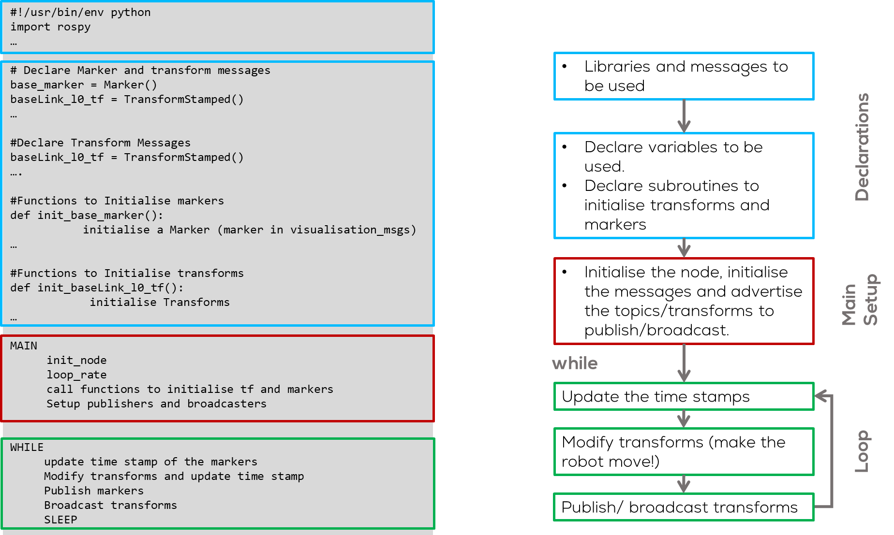

Slide 9
Simple Manipulator
Part 1: Transforms

Slide 10
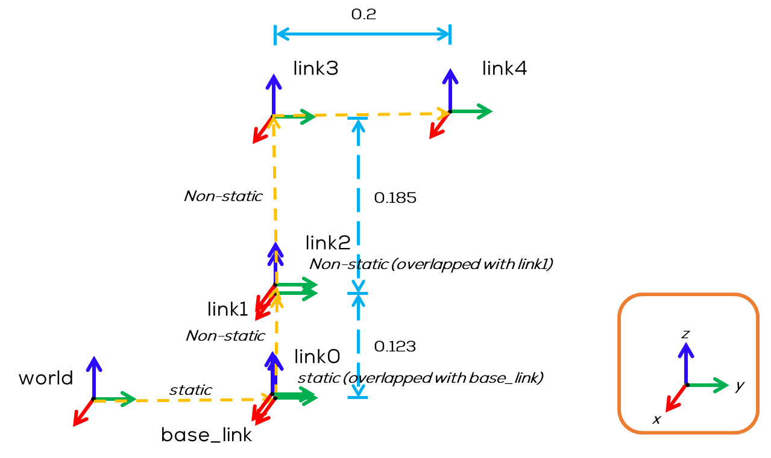
Transforms to be broadcasted
Transforms
The transforms to be defined are the following:
Transform 1:
Father frame: world
Child frame: base_link
Type: static
Translation: x, y, z= user-defined
Rotation: User defined
Information: Position of the manipulator
Transform 2:
Father frame: base_link
Child frame: link0
Type: Static
Translation: x=0, y=0, z=0
Rotation: r=0 , p=0, yaw=0
Information = Overlapping base_link

Slide 11
Transforms to be broadcasted
Transforms
The transforms to be defined are the following:
Transform 3:
Father frame: link0
Child frame: link1
Type: Non-Static
Translation: x=0, y=0, z=0.123
Rotation: r=0 , p=0, yaw=0
Information: Joint 1 rotation about the z-axis
Transform 4:
Father frame: link1
Child frame: link2
Type: Non-static
Translation: x=0, y=0, z=0
Rotation: r=0 , p=0, yaw=0
Information: Joint 2, Overlapping link1, rotation about the x-axis

Slide 12
Transforms to be broadcasted
Transforms
The transforms to be defined are the following:
Transform 5:
Father frame: link2
Child frame: link3
Type: Non-Static
Translation: x=0, y=0, z=0.185
Rotation: r=0 , p=0, yaw=0
Information: Joint 3 rotation about the x-axis
Transform 6:
Father frame: link3
Child frame: link4
Type: Non-static
Translation: x=0, y=0.2, z=0
Rotation: r=0 , p=0, yaw=0
Information: Joint 4, Rotation about the y-axis

Slide 13
Code Part 1: Transforms
Code
Open the file “manipulator.py”
Copy the following template and save.
Be careful with the tabs!
if __name__=='__main__':
#Initialise and Setup node
rospy.init_node("manipulator_ex")
# Configure the Node
loop_rate = rospy.Rate(100)
#Functions to initialise markers and transforms
#Setup Publishers,subscribers and transform broadcasters
try:
#Run the node
while not rospy.is_shutdown():
#Declare time variable
t = rospy.Time.now().to_sec()
#Update the markers time stamp
# Define the transform movements
#Update the transforms time stamps and movements
#Broadcast transforms
#Publish markers
loop_rate.sleep()
except rospy.ROSInterruptException:
pass
#!/usr/bin/env python
import rospy
import numpy as np
from geometry_msgs.msg import TransformStamped
from visualization_msgs.msg import Marker
from tf2_ros import TransformBroadcaster, StaticTransformBroadcaster
# Setup parameters, transforms, variables and callback functions here (if required)
# Declare Marker messages
#Declare Transform Messages
#################### Functions to Initialise Markers######################
#Functions to initialise markers
##########################################################################
################## ## Initialise Transform Messages#######################
#Functions to initialise transforms
##########################################################################

Slide 14
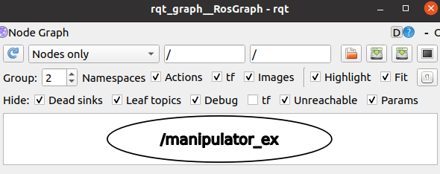
Code Part 1: Transforms
Running the node
Open a terminal and re-build your package
Run ROS
Open a new terminal and run the node you just made using the following command
Open a new terminal and run the rqt_graph
Results
You won't be able to see anything else since there is no program; this is just a checkpoint to make sure everything is running smoothly.
$ cd ~/catkin_ws
$ catkin_make
$ source devel/setup.bash
$ roscore
$ rosrun simple_manipulator manipulator.py
$ rosrun rqt_graph rqt_graph

Slide 15
Code Part 1: Transforms
Code (Steps)
In the file “manipulator.py” declare the first transform message “baseLink_l0_tf” to be used in the “Declarations” section (yellow section).
Define the function “init_baseLink_l0_tf()” to initialise the transform message in the “Declarations” section.
In the “main setup” section, call the previously defined function
Define a transform broadcaster for the previously defined transform (“Main setup” section).
In the “Loop” section, update the time stamp of the transform before broadcast it.
#Functions to initialise markers and transforms
init_baseLink_l0_tf()
#Declare Transform Messages
baseLink_l0_tf = TransformStamped()
#Setup Publishers, subscribers and transform broadcasters here
bc_baselink = StaticTransformBroadcaster()
#################### Initialise Transform Messages ######################
def init_baseLink_l0_tf():
baseLink_l0_tf.header.frame_id = "base_link"
baseLink_l0_tf.child_frame_id = "link0"
baseLink_l0_tf.header.stamp = rospy.Time.now()
baseLink_l0_tf.transform.translation.x = 0
baseLink_l0_tf.transform.translation.y = 0
baseLink_l0_tf.transform.translation.z = 0.0
baseLink_l0_tf.transform.rotation.x = 0
baseLink_l0_tf.transform.rotation.y = 0
baseLink_l0_tf.transform.rotation.z = 0
baseLink_l0_tf.transform.rotation.w = 1
#Update the transforms
baseLink_l0_tf.header.stamp = rospy.Time.now()
#Broadcast transforms
bc_baselink.sendTransform(baseLink_l0_tf)

Slide 16
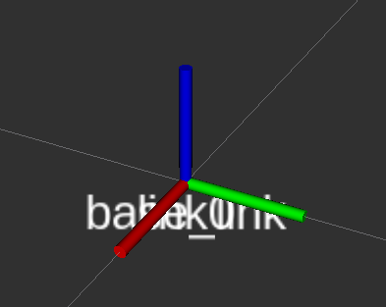
Code Part 1: Transforms
Running the node
Open a terminal and re-build your package
Run ROS
Open a new terminal and run the node you just made using the following command
Open a new terminal and run the rviz
In the “Fixed Frame” option in RVIZ GUI (top left corner) change it to “base_link”.
Press de “Add” button in the bottom left corner of the RVIZ GUI, look for “TF” option on the menu and add it by selecting it and pressing “OK”
Results
$ cd ~/catkin_ws
$ catkin_make
$ source devel/setup.bash
$ roscore
$ rosrun simple_manipulator manipulator.py
$ rosrun rviz rviz

Slide 17
Code Part 1: Transforms
def init_l1_l2_tf():
l1_l2_tf.header.frame_id = "link1"
l1_l2_tf.child_frame_id = "link2"
l1_l2_tf.header.stamp = rospy.Time.now()
l1_l2_tf.transform.translation.x = 0
l1_l2_tf.transform.translation.y = 0
l1_l2_tf.transform.translation.z = 0.0
l1_l2_tf.transform.rotation.x = 0
l1_l2_tf.transform.rotation.y = 0
l1_l2_tf.transform.rotation.z = 0
l1_l2_tf.transform.rotation.w = 1
def init_l2_l3_tf():
l2_l3_tf.header.frame_id = "link2"
l2_l3_tf.child_frame_id = "link3"
l2_l3_tf.header.stamp = rospy.Time.now()
l2_l3_tf.transform.translation.x = 0
l2_l3_tf.transform.translation.y = 0
l2_l3_tf.transform.translation.z = 0.185
l2_l3_tf.transform.rotation.x = 0
l2_l3_tf.transform.rotation.y = 0
l2_l3_tf.transform.rotation.z = 0
l2_l3_tf.transform.rotation.w = 1
def init_l3_l4_tf():
l3_l4_tf.header.frame_id = "link3"
l3_l4_tf.child_frame_id = "link4"
l3_l4_tf.header.stamp = rospy.Time.now()
l3_l4_tf.transform.translation.x = 0
l3_l4_tf.transform.translation.y = 0.2
l3_l4_tf.transform.translation.z = 0
l3_l4_tf.transform.rotation.x = 0
l3_l4_tf.transform.rotation.y = 0
l3_l4_tf.transform.rotation.z = 0
l3_l4_tf.transform.rotation.w = 1
Code
Repeat steps 1-5 of the previous two slides, and add the following transformations, in their respective sections
Declariation Section
#Declare Transform Messages
l0_l1_tf = TransformStamped()
l1_l2_tf = TransformStamped()
l2_l3_tf = TransformStamped()
l3_l4_tf = TransformStamped()
l4_l5_tf = TransformStamped()
#################### Initialise Transform Messages ######################
def init_baseLink_l0_tf():
. . . (the definition is here but not enough space in the slide)
def init_l0_l1_tf():
l0_l1_tf.header.frame_id = "link0"
l0_l1_tf.child_frame_id = "link1"
l0_l1_tf.header.stamp = rospy.Time.now()
l0_l1_tf.transform.translation.x = 0
l0_l1_tf.transform.translation.y = 0
l0_l1_tf.transform.translation.z = 0.123
l0_l1_tf.transform.rotation.x = 0
l0_l1_tf.transform.rotation.y = 0
l0_l1_tf.transform.rotation.z = 0
l0_l1_tf.transform.rotation.w = 1

Slide 18
Code Part 1: Transforms
Code
Repeat steps 1-5 of the previous two slides, and add the following transformations, in their respective sections
Main Setup Section
Loop Section
Add the rotations for the other transforms (the previous was static)
Rotations are defined in quaternions so we must use the tf_conversion library to convert from Euler angles to quaternions
#Functions to initialise markers and transforms
init_baseLink_l0_tf()
init_l0_l1_tf()
init_l1_l2_tf()
init_l2_l3_tf()
init_l3_l4_tf()
# Define the transform movements
q_l1 = tf_conversions.transformations.quaternion_from_euler(0, 0, 0.5*np.sin(0.5*t))
q_l2 = tf_conversions.transformations.quaternion_from_euler(0.5*np.sin(t), 0, 0)
q_l3 = tf_conversions.transformations.quaternion_from_euler(0.5*np.cos(t), 0, 0)
q_l4 = tf_conversions.transformations.quaternion_from_euler(0, 0.5*np.cos(t), 0)
#Setup Publishers, subscribers and transform broadcasters here
bc_baselink = StaticTransformBroadcaster()
bc_l0 = TransformBroadcaster()
bc_l1 = TransformBroadcaster()
bc_l2 = TransformBroadcaster()
bc_l3 = TransformBroadcaster()
bc_l4 = TransformBroadcaster()
bc_l5 = TransformBroadcaster()

Slide 19
Code Part 1: Transforms
Loop Section
Update the transforms
Loop Section
Broadcast the transforms
#Update the transforms time stamps and movements
baseLink_l0_tf.header.stamp = rospy.Time.now()
l0_l1_tf.header.stamp = rospy.Time.now()
l0_l1_tf.transform.rotation.x = q_l1[0]
l0_l1_tf.transform.rotation.y = q_l1[1]
l0_l1_tf.transform.rotation.z = q_l1[2]
l0_l1_tf.transform.rotation.w = q_l1[3]
l1_l2_tf.header.stamp = rospy.Time.now()
l1_l2_tf.transform.rotation.x = q_l2[0]
l1_l2_tf.transform.rotation.y = q_l2[1]
l1_l2_tf.transform.rotation.z = q_l2[2]
l1_l2_tf.transform.rotation.w = q_l2[3]
l2_l3_tf.header.stamp = rospy.Time.now()
l2_l3_tf.transform.rotation.x = q_l3[0]
l2_l3_tf.transform.rotation.y = q_l3[1]
l2_l3_tf.transform.rotation.z = q_l3[2]
l2_l3_tf.transform.rotation.w = q_l3[3]
l3_l4_tf.header.stamp = rospy.Time.now()
l3_l4_tf.transform.rotation.x = q_l4[0]
l3_l4_tf.transform.rotation.y = q_l4[1]
l3_l4_tf.transform.rotation.z = q_l4[2]
l3_l4_tf.transform.rotation.w = q_l4[3]
#Broadcast transforms
bc_baselink.sendTransform(baseLink_l0_tf)
bc_l0.sendTransform(l0_l1_tf)
bc_l1.sendTransform(l1_l2_tf)
bc_l2.sendTransform(l2_l3_tf)
bc_l3.sendTransform(l3_l4_tf)

Slide 20
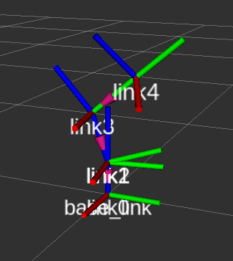
Code Part 1: Transforms
Running the node
Open a terminal and re-build your package
Run ROS
Open a new terminal and run the node you just made using the following command
Open a new terminal and run the rviz
In the “Fixed Frame” option in RVIZ GUI (top left corner) change it to “base_link”.
Press de “Add” button in the bottom left corner of the RVIZ GUI, look for “TF” option on the menu and add it by selecting it and pressing “OK”
Results
$ cd ~/catkin_ws
$ catkin_make
$ source devel/setup.bash
$ roscore
$ rosrun simple_manipulator manipulator.py
$ rosrun rviz rviz

Slide 21
Simple Manipulator
Part 2: Markers

Slide 22
Robot Description
Description
Six markers will be added to form the manipulator.
The marker, in this case, represents the joints and the body of the manipulator.
The markers to be used are cylinders, the user can select any other shape.
Each marker will be attached to a frame in a different position.
The movement of the frame will move the marker accordingly.

Slide 23
arm5_marker:
arm4_marker:
arm3_marker:
arm2_marker:
arm1_marker:
base_marker:

Slide 24
arm2_marker:
frame: link2
Type: cylinder
Height: 0.085
Diameter: 0.1
Position: x=0, y=0, z=0.0925
Rotation: r=0, p=0, y=0
arm5_marker:
frame: link4
Type: cylinder
Height: 0.1
Diameter: 0.1
Position: x=0, y=0, z=0
Rotation: r=0, p=0, y=0
arm1_marker:
frame: link2
Type: cylinder
Height: 0.1
Diameter: 0.1
Position: x=0, y=0, z=0.0365
Rotation: r=0, p=pi/2, y=0
arm4_marker:
frame: link3
Type: cylinder
Height: 0.1
Diameter: 0.1
Position: x=0, y=0.1, z=0
Rotation: r=pi/2, p=0, y=0
base_marker:
frame: link0
Type: cylinder
Height: 0.073
Diameter: 0.1
Position: x=0, y=0, z=0.0365
Rotation: r=0, p=0, y=0
arm3_marker:
frame: link3
Type: cylinder
Height: 0.1
Diameter: 0.1
Position: x=0, y=0, z=0
Rotation: r=0, p=pi/2, y=0

Slide 25
Code Part 2: Markers
Code (Steps)
In the file “manipulator.py” declare the first marker message “baseLink_l0_tf” to be used in the “Declarations” section (yellow section).
Define the function “def init_base_marker()” to initialise the marker message in the “Declarations” section.
########## Functions to Initialise Markers###############################
#Functions to initialise markers
def init_base_marker():
# Declare the link0 Marker Message
base_marker.header.frame_id = "link0"
base_marker.header.stamp = rospy.Time.now()
base_marker.id = 0
base_marker.type = 3
base_marker.action = 0
base_marker.pose.position.x = 0.0
base_marker.pose.position.y = 0.0
base_marker.pose.position.z = (0.123-0.05)/2
base_marker.pose.orientation.x = 0
base_marker.pose.orientation.y = 0
base_marker.pose.orientation.z = 0
base_marker.pose.orientation.w = 1
base_marker.scale.x = 0.1
base_marker.scale.y = 0.1
base_marker.scale.z = 0.123-0.05
base_marker.color.r = 0.0
base_marker.color.g = 1.0
base_marker.color.b = 0.0
base_marker.color.a = 1.0
base_marker.lifetime = rospy.Duration(0)
# Declare Marker messages
base_marker = Marker()

Slide 26
Code Part 2: Markers
In the “main setup” section, call the previously defined function
Define a publisher for the previously defined marker (“Main setup” section).
In the “Loop” section, update the time stamp of the marker before publishing it.
Running the node
Open a terminal and re-build your package
Run ROS
Open a new terminal and run the node you just made using the following command
Open a new terminal and run the rviz
#Functions to initialise markers and transforms
init_base_marker()
$ cd ~/catkin_ws
$ catkin_make
$ source devel/setup.bash
$ roscore
#Setup Publishers, subscribers
pub_link0 = rospy.Publisher('/link0', Marker, queue_size=1)
$ rosrun simple_manipulator manipulator.py
#Update the transforms
baseLink_l0_tf.header.stamp = rospy.Time.now()
#Publish markers
pub_link0.publish(base_marker)
$ rosrun rviz rviz

Slide 27
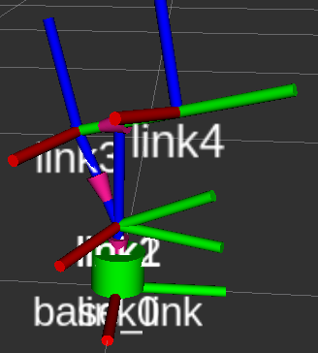
Code Part 2: Markers
In the “Fixed Frame” option in RVIZ GUI (top left corner) change it to “base_link”.
Press de “Add” button in the bottom left corner of the RVIZ GUI.
Look for “TF” option on the menu and add it by selecting it and pressing “OK”
Repeat step 11 and select “By topic” at the top part of the pop-up window. Select “/link0/Marker” and add it.
Results

Slide 28
Code Part 2: Markers
Code
Repeat steps 1-5 of the previous two slides, and add the following markers, in their respective sections
Declaration Section
#Functions to initialise markers
def init_base_marker():
. . . (the definition is here but not enough space in the slide)
def init_arm1_marker():
# Declare the link1 Marker Message
q_m1 = tf_conversions.transformations.quaternion_from_euler(0, np.pi/2, 0)
arm1_marker.header.frame_id = "link2"
arm1_marker.header.stamp = rospy.Time.now()
arm1_marker.id = 0
arm1_marker.type = 3
arm1_marker.action = 0
arm1_marker.pose.position.x = 0.0
arm1_marker.pose.position.y = 0.0
arm1_marker.pose.position.z = 0.0
arm1_marker.pose.orientation.x = q_m1[0]
arm1_marker.pose.orientation.y = q_m1[1]
arm1_marker.pose.orientation.z = q_m1[2]
arm1_marker.pose.orientation.w = q_m1[3]
arm1_marker.scale.x = 0.1
arm1_marker.scale.y = 0.1
arm1_marker.scale.z = 0.1
arm1_marker.color.r = 0.0
arm1_marker.color.g = 1.0
arm1_marker.color.b = 0.0
arm1_marker.color.a = 1.0
arm1_marker.lifetime = rospy.Duration(0)
# Declare Marker messages
base_marker = Marker()
arm1_marker = Marker()
arm2_marker = Marker()
arm3_marker = Marker()
arm4_marker = Marker()
arm5_marker = Marker()

Slide 29
Code Part 2: Markers
Code
Declaration Section
def init_arm2_marker():
# Declare the link2 Marker Message
arm2_marker.header.frame_id = "link2"
arm2_marker.header.stamp = rospy.Time.now()
arm2_marker.id = 0
arm2_marker.type = 3
arm2_marker.action = 0
arm2_marker.pose.position.x = 0.0
arm2_marker.pose.position.y = 0.0
arm2_marker.pose.position.z = (0.185-0.1)/2+0.05
arm2_marker.pose.orientation.x = 0
arm2_marker.pose.orientation.y = 0
arm2_marker.pose.orientation.z = 0
arm2_marker.pose.orientation.w = 1
arm2_marker.scale.x = 0.1
arm2_marker.scale.y = 0.1
arm2_marker.scale.z = 0.185-0.1
arm2_marker.color.r = 0.0
arm2_marker.color.g = 1.0
arm2_marker.color.b = 0.0
arm2_marker.color.a = 1.0
arm2_marker.lifetime = rospy.Duration(0)
def init_arm3_marker():
# Declare the link3 Marker Message
q_m3 = tf_conversions.transformations.quaternion_from_euler(0, np.pi/2, 0)
arm3_marker.header.frame_id = "link3"
arm3_marker.header.stamp = rospy.Time.now()
arm3_marker.id = 0
arm3_marker.type = 3
arm3_marker.action = 0
arm3_marker.pose.position.x = 0.0
arm3_marker.pose.position.y = 0.0
arm3_marker.pose.position.z = 0.0
arm3_marker.pose.orientation.x = q_m3[0]
arm3_marker.pose.orientation.y = q_m3[1]
arm3_marker.pose.orientation.z = q_m3[2]
arm3_marker.pose.orientation.w = q_m3[3]
arm3_marker.scale.x = 0.1
arm3_marker.scale.y = 0.1
arm3_marker.scale.z = 0.1
arm3_marker.color.r = 0.0
arm3_marker.color.g = 1.0
arm3_marker.color.b = 0.0
arm3_marker.color.a = 1.0
arm3_marker.lifetime = rospy.Duration(0)

Slide 30
Code Part 2: Markers
Code
Declaration Section
def init_arm4_marker():
# Declare the link4 Marker Message
q_m4 = tf_conversions.transformations.quaternion_from_euler(np.pi/2, 0, 0)
arm4_marker.header.frame_id = "link3"
arm4_marker.header.stamp = rospy.Time.now()
arm4_marker.id = 0
arm4_marker.type = 3
arm4_marker.action = 0
arm4_marker.pose.position.x = 0.0
arm4_marker.pose.position.y = (0.2-0.1)/2+0.05
arm4_marker.pose.position.z = 0.0
arm4_marker.pose.orientation.x = q_m4[0]
arm4_marker.pose.orientation.y = q_m4[1]
arm4_marker.pose.orientation.z = q_m4[2]
arm4_marker.pose.orientation.w = q_m4[3]
arm4_marker.scale.x = 0.1
arm4_marker.scale.y = 0.1
arm4_marker.scale.z = 0.2-0.1
arm4_marker.color.r = 0.0
arm4_marker.color.g = 1.0
arm4_marker.color.b = 0.0
arm4_marker.color.a = 1.0
arm4_marker.lifetime = rospy.Duration(0)
def init_arm5_marker():
arm5_marker.header.frame_id = "link4"
arm5_marker.header.stamp = rospy.Time.now()
arm5_marker.id = 0
arm5_marker.type = 3
arm5_marker.action = 0
arm5_marker.pose.position.x = 0.0
arm5_marker.pose.position.y = 0.0
arm5_marker.pose.position.z = 0.0
arm5_marker.pose.orientation.x = 0
arm5_marker.pose.orientation.y = 0
arm5_marker.pose.orientation.z = 0
arm5_marker.pose.orientation.w = 1
arm5_marker.scale.x = 0.1
arm5_marker.scale.y = 0.1
arm5_marker.scale.z = 0.1
arm5_marker.color.r = 0.0
arm5_marker.color.g = 1.0
arm5_marker.color.b = 0.0
arm5_marker.color.a = 1.0
arm5_marker.lifetime = rospy.Duration(0)

Slide 31
Code Part 2: Markers
In the “main setup” section
In the Loop section
#Update the markers
base_marker.header.stamp = rospy.Time.now()
arm1_marker.header.stamp = rospy.Time.now()
arm2_marker.header.stamp = rospy.Time.now()
arm3_marker.header.stamp = rospy.Time.now()
arm4_marker.header.stamp = rospy.Time.now()
arm5_marker.header.stamp = rospy.Time.now()
#Publish markers
pub_link0.publish(base_marker)
pub_link1.publish(arm1_marker)
pub_link2.publish(arm2_marker)
pub_link3.publish(arm3_marker)
pub_link4.publish(arm4_marker)
pub_link5.publish(arm5_marker)
#Functions to initialise markers and transforms
init_base_marker()
init_arm1_marker()
init_arm2_marker()
init_arm3_marker()
init_arm4_marker()
init_arm5_marker()
#Setup Publishers, subscribers
pub_link0 = rospy.Publisher('/link0', Marker, queue_size=1)
pub_link1 = rospy.Publisher('/link1', Marker, queue_size=1)
pub_link2 = rospy.Publisher('/link2', Marker, queue_size=1)
pub_link3 = rospy.Publisher('/link3', Marker, queue_size=1)
pub_link4 = rospy.Publisher('/link4', Marker, queue_size=1)
pub_link5 = rospy.Publisher('/link5', Marker, queue_size=1)

Slide 32
Code Part 2: Transforms
Running the node
Open a terminal and re-build your package
Run ROS
Open a new terminal and run the node you just made using the following command
Open a new terminal and run the rviz
In the “Fixed Frame” option in RVIZ GUI (top left corner) change it to “base_link”.
Press de “Add” button in the bottom left corner of the RVIZ GUI, look for “TF” option on the menu and add it by selecting it and pressing “OK”
Repeat the previous step and select “By topic” at the top part of the pop-up window. Select and add all the markers.
You can save RVIZ configuration by going to File>>Save Config As.
Set a name “robot_rviz.rviz”
It is recommended for you to save on a folder called ”rviz” inside your package “simple_manipulator”
$ cd ~/catkin_ws
$ catkin_make
$ source devel/setup.bash
$ roscore
$ rosrun simple_manipulator manipulator.py
$ rosrun rviz rviz

Slide 33
Code Part 2: Transforms

Slide 34
Launch File
Define a launch file
Open a terminal
Open the file and write the following
In this file a static transform from the frame “world” to “base_link” is being created (change the “Fixed Frame” in Rviz).
$ cd ~/catkin_ws/src/simple_manipulator
$ mkdir launch
$ cd launch
$ touch robot.launch
<?xml version="1.0" ?>
<launch>
<node name="robot" pkg="simple_manipulator" type="manipulator.py" output="screen"/>
<arg name="rvizconfig" default="$(find simple_manipulator)/rviz/robot_rviz.rviz" />
<node name="rviz" pkg="rviz" type="rviz" args="-d $(arg rvizconfig)" required="true" />
<node pkg="tf2_ros" type="static_transform_publisher" name="world_tf" args="0 0 0 0 0 0 world base_link"/>
</launch>

Slide 35
Results

